Slide 1


Costruire sistemi multi-agente efficaci con Semantic Kernel: tecnologie e sfide
Anna Fabris
Machine Learning Engineer
Impresoft 4ward
Matteo Pagani
Cloud Solution Architect
Modern Work Global CSU
Microsoft

Slide 2
WHAT IS A MULTIAGENT SYSTEM?
A multiagent system (MAS) is a group of autonomous AI agents working together to solve complex tasks.
AGENTS
INTERACTIONS
Individual parts of the system.
Each agent has its own abilities, knowledge, and goals. Agents can be language models, tools.​..
Agents interact with each other with various methods, such as talking to each other, working together, or competing.​
Notes:
A Multi-Agent System (MAS) is a type of computer system where multiple independent entities, called agents, work together or compete in a shared environment to reach their goals. Unlike single-agent systems, where one agent handles tasks alone, MAS involves several agents interacting with each other and their surroundings.
"Each agent is a specialized team member with its own abilities, knowledge, and goals. Think language models, data analysis tools, or specialized processors. They're autonomous - they make their own decisions within their role."
"The magic happens when agents communicate and collaborate. They share information, divide tasks based on strengths, and coordinate efforts. Sometimes they even compete to find the best solution."
"Like customer service - one agent understands questions, another searches databases, a third crafts responses. Together, they're much more effective than working alone."

Slide 3
CHALLENGES OF MULTIAGENT SYSTEMS
CONTROLLABILITY
COORDINATION COMPLEXITY
UNPREDICTABLE BEHAVIOR
Difficulty having control on the behavior of the system
Preventing conflicts and ensuring coherent collective behavior
Detecting issues is complicated due to the independency of agents
ERROR PROPAGATION
COST
TASK TERMINATION
Error from a single LLM agent can propagate through the network
Calling too many LLM inferences can become very expensive
Avoiding infinite loops in long task can be challenging.
Notes:
While multiagent systems are powerful, they're not without problems. Managing multiple autonomous agents creates several key challenges."
Controllability
When you have multiple independent agents making decisions, it becomes harder to predict and control the overall system behavior. You might tell them the goal, but they might take unexpected paths to get there.
Coordination Complexity
Second is coordination complexity. Getting agents to work together smoothly is difficult. They need to communicate, avoid conflicts, and synchronize their actions. More agents means exponentially more coordination challenges."
Unpredictable Behavior:
"This leads to unpredictable behavior - emergent properties you didn't plan for. And all this complexity means higher computational costs and development time. So why not just use one powerful LLM instead

Slide 4
WHY NOT JUST ONE LLM?
FLEXIBILITY
SCALABILITY
SPECIALIZATION
PERFORMANCE
Multiagent systems can adjust to varying environments by adding, removing or adapting agents.
A single LLM can only "remember" a limited amount of input (limited context window)
Different agents can be trained or prompted to excel at specific tasks
Multiagent frameworks tend to outperform singular agents
Notes:
Flexibility
A multiagent system can adapt by swapping out individual agents or adding new ones without rebuilding everything. Need better math capabilities? Just upgrade the math agent. One monolithic LLM requires retraining the entire system.
Scalability
"Second, scalability. You can distribute agents across different servers, scale up specific capabilities as needed, and handle much larger workloads. One LLM hits hardware limits quickly."
Performance
"A coding-focused agent will outperform a general LLM at programming tasks. Multiple specialists working together often beat one generalist, just like in human teams."

Slide 5
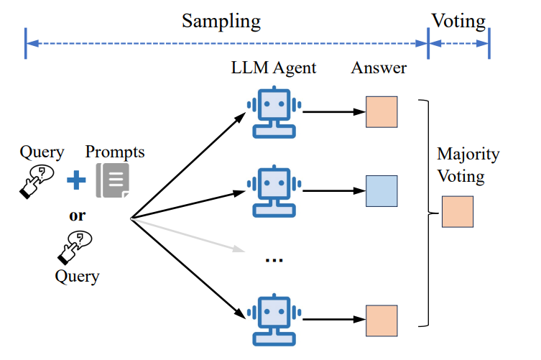
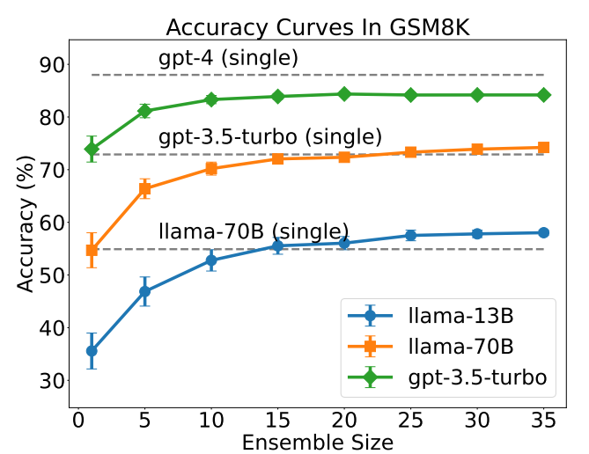
ARCHITECTURE: AGENT FOREST
Li, Junyou, et al. "More agents is all you need." arXiv preprint arXiv:2402.05120 (2024)
Notes:
The Agent Forest method focuses on scaling LLM performance by simply increasing the number of agents. The method employs a sampling-andvoting approach: multiple agents generate responses, and the final answer is determined through majority voting. This technique demonstrates that increasing the number of agents improves performance, particularly on complex tasks. However, it also reveals limitations: the performance gains from Agent Forest depend on the inherent difficulty of the task, with diminishing returns for overly complex or overly simple tasks;
When the ensemble size scales up to 15, Llama2-13B achieves comparable accuracy with Llama2-70B. Similarly, When the ensemble size scales up to 15 and 20, Llama2-70B and GPT-3.5-Turbo achieve comparable accuracy with their more powerful counterparts. The error bars represent the standard error.

Slide 6
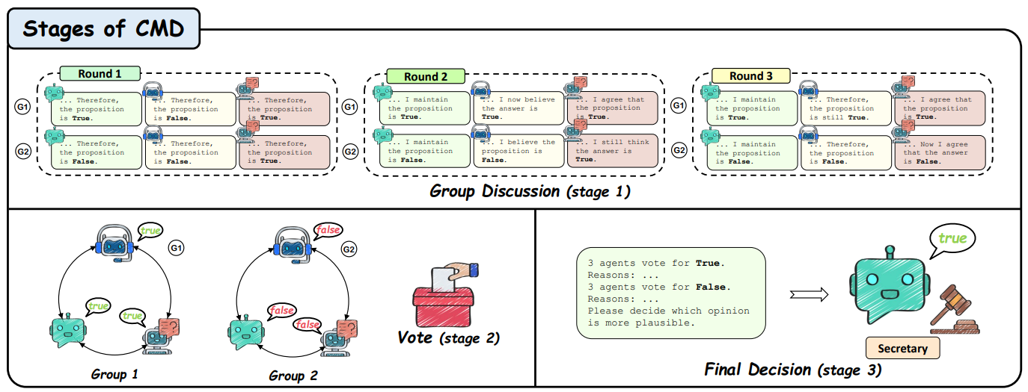
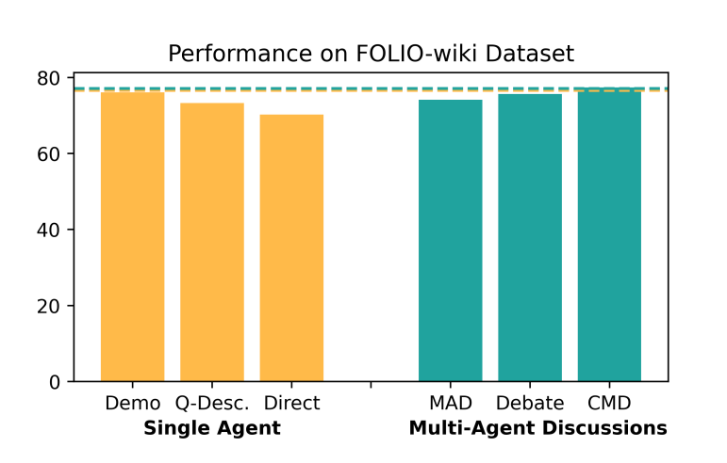
ARCHITECTURE: CONQUER-AND-MERGE DISCUSSION
Wang, Qineng, et al. "Rethinking the bounds of LLM reasoning: Are multi-agent discussions the key?." arXiv preprint arXiv:2402.18272 (2024).
Notes:
Stage 1: Group Discussion. During this stage, agents A are divided into groups G = {Gk} t k=1 with an equal size. All agents are asked to solve task Q through discussion. For each agent Ai ∈ Gk, all answers and explanations from Ai ∈ Gk in the last round are accessible where Aj ∈ Gk and j ̸= i. In contrast, they can only see the answers without explanations from agents in other groups. After R rounds of discussions, CMD moves to the voting stage.
Stage 2: Voting. When discussion reaches the maximum number of rounds, all agents A start voting. Each vote of agent in this discussion is treated equally, therefore, the result is determined by the majority decision. In the event of a tie, CMD transitions to
Stage 3. Otherwise, the discussion process concludes formally. Stage 3: Final Decision. If a tie occurs, we introduce an extra agent S in the role of the secretary to make the final decision. Each proposed answer is accompanied by an explanation selected from agents with the same opinion and provided to the secretary for the final determination. To sum up, the final decision is made by either Vote(A) or S(V, O|Q) where V = {vi} n and O = {oi} n , representing a set of viewpoints and a set of explanations respectively.
Figure 2 presents a comparison between single agent settings and multi-agent discussion frame-works on FOLIO-wiki. In this figure, ‘Demo’ means that the tested single agent is provided with a demonstration case, ‘Q-Desc.’ indicates that the single agent is provided with detailed question description, while ‘Direct’ refers to the single agent without demonstrations. We observe that the single agent ‘Demo’ tends to reach a performance upper bound similar to that of all discussion frameworks, which will be further elaborated on later. This result suggests that the previous claim is NOT fully established.
CMD has only been tested on reasoning tasks, leaving its applicability to broader domains such as strategic planning or real-time decision-making unexplored.
In the absence of demonstrations, multi-agent discussion frameworks outperform single agents on most tasks;

Slide 7

DOMANDE?
Demo e slide su
https://github.com/
qmatteoq/AgentCon2025

Slide 8
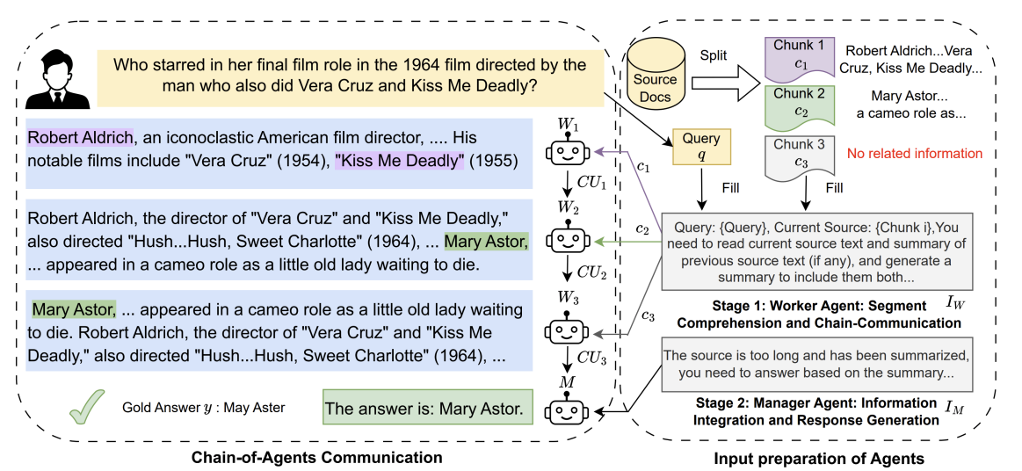
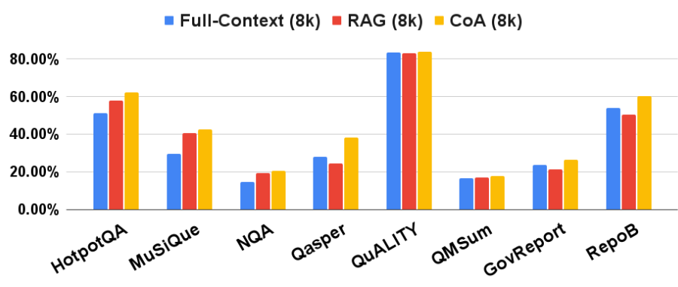
ARCHITECTURE: CHAIN-OF-AGENTS
Zhang, Yusen, et al. "Chain of agents: Large language models collaborating on long-context tasks." Advances in Neural Information Processing Systems 37 (2024)
https://research.google/blog/chain-of-agents-large-language-models-collaborating-on-long-context-tasks/
Notes:
This architecture is designed for handling long context tasks that surpass the token limits of individual LLMs. Two common strategies have emerged: 1) reducing the input length, such as retrieving relevant chunks by Retrieval-Augmented Generation (RAG), and 2) expanding the context window limit of LLM. However, both strategies have drawbacks: input reduction has no guarantee of covering the part with needed information, while window extension struggles with focusing on the pertinent information for solving the task. To mitigate these limitations, we propose Chain-of-Agents (CoA), it consists of worker agents that sequentially process portions of the input and pass their results to a manager agent, which aggregates the final output. The CoA architecture’s key innovation is the interleaved read-process method, allowing agents to process chunks of input before receiving the full context.

Slide 9
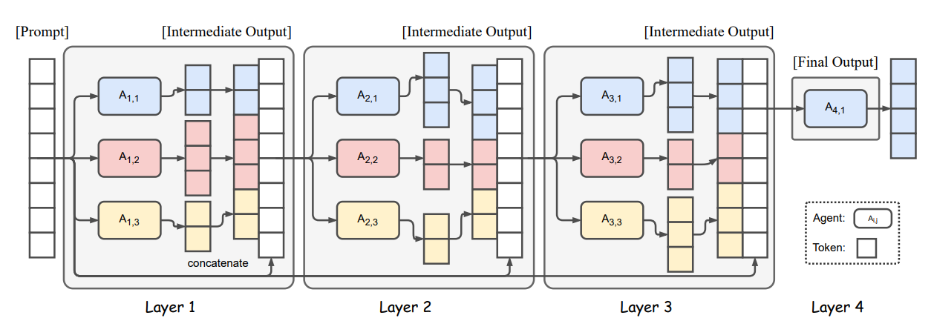
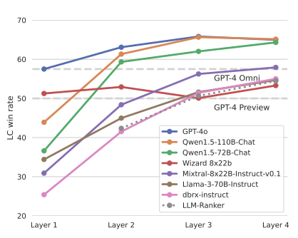
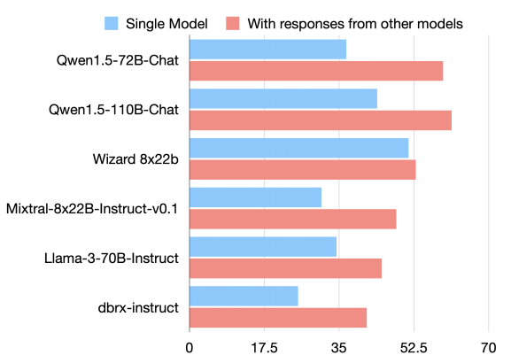
ARCHITECTURE: MIXTURE-OF-AGENTS
Wang, Junlin, et al. "Mixture-of-agents enhances large language model capabilities." arXiv preprint arXiv:2406.04692 (2024)
Notes:
In our approach, we construct a layered MoA architecture wherein each layer comprises multiple LLM agents. Each agent takes all the outputs from agents in the previous layer as auxiliary information in generating its response.
Agents collaborate in both proposer and aggregator roles. Proposers generate diverse responses, while aggregators synthesize the responses into high-quality outputs. MoA excels by leveraging the strengths of different LLMs, enabling specialized roles for various agents. Expanding the number of agents and aggregators introduces complexity in managing collaboration, which may require more sophisticated orchestration techniques in the future.

Slide 10
MEMORY
SHARED MEMORY
Centralized knowledge base accessible by all agents
DISTRIBUTED MEMORY
Agent-specific memory stores for specialized knowledge and local context
CONTEXUAL MEMORY
Stored temporarily in prompt or system message
PERSISTENT MEMORY
External storage (Vector Databases, Files, SQL)
Notes:
Memory is crucial for multiagent systems - agents need to remember past interactions, share knowledge, and access information efficiently. There are four key memory approaches.
Shared Memory
First, shared memory - think of it as a centralized library that all agents can access. Every agent can read and write to this common knowledge base, ensuring everyone has access to the same core information and updates.
Distributed Memory
Second, distributed memory - each agent maintains its own specialized memory stores. Like different departments keeping their own files, this allows agents to store context and knowledge specific to their role without cluttering the shared space.

Slide 11
FRAMEWORKS
LangGraph
CrewAI
Graph-based workflows with stateful agent interactions
Role-playing agents collaborating as teams
AutoGen
Semantic Kernel
Multi-agent conversations with code execution
Integrating AI into existing enterprise applications
Notes:
LangGraph - This is part of the LangChain ecosystem and excels at creating complex workflows where agents need to maintain state and interact in cycles. Think of it as building a flowchart where agents can loop back and remember previous steps.
CrewAI - This framework treats AI agents like team members with specific roles. You can create a crew where one agent is the researcher, another is the writer, and a third is the editor - all working together on a project.
AutoGen - Microsoft's approach focuses on conversations between agents. It's particularly strong when you need agents to discuss problems, generate code, and execute it. Great for debugging and iterative problem-solving.
Semantic Kernel - Also from Microsoft, but this is more about integrating AI into existing enterprise applications. It's the bridge between your current codebase and AI capabilities, supporting multiple programming languages.
Each framework has its sweet spot - LangGraph for complex workflows, CrewAI for team-based tasks, AutoGen for conversational problem-solving, and Semantic Kernel for enterprise integration
LAUNCH TO SEMANTIC KERNEL PART

Slide 12
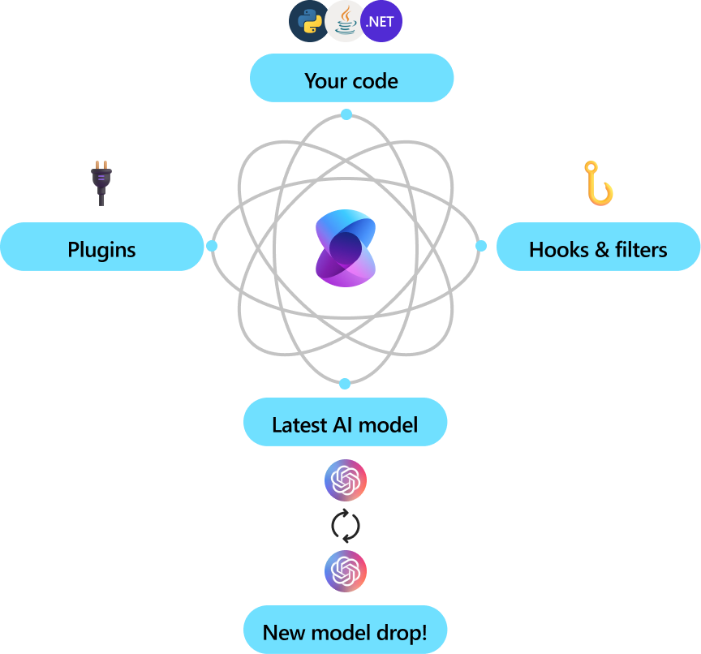
SEMANTIC KERNEL
Lightweight, open-source development kit that lets you easily build AI agents and integrate the latest AI models into your C#, Python, or Java codebase
Built-in support for multiple AI services, cloud-based or local
Built-in support for plugins and memory, with integration with the most popular vector database
Multi-agent capabilities, with support for local agents, Prompty-based agents and Azure AI Foundry agents

Slide 13
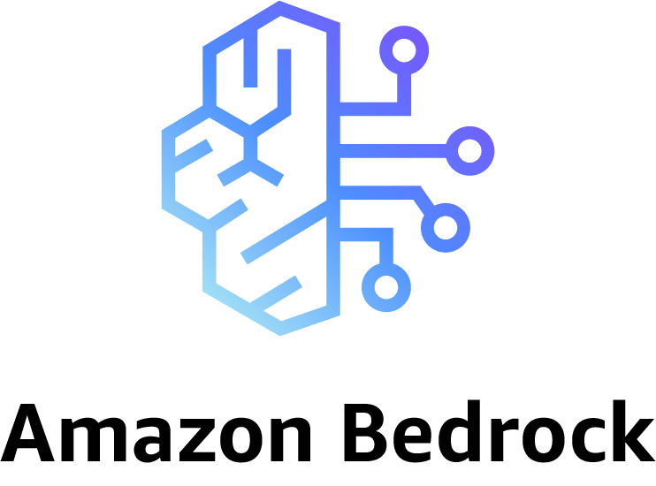



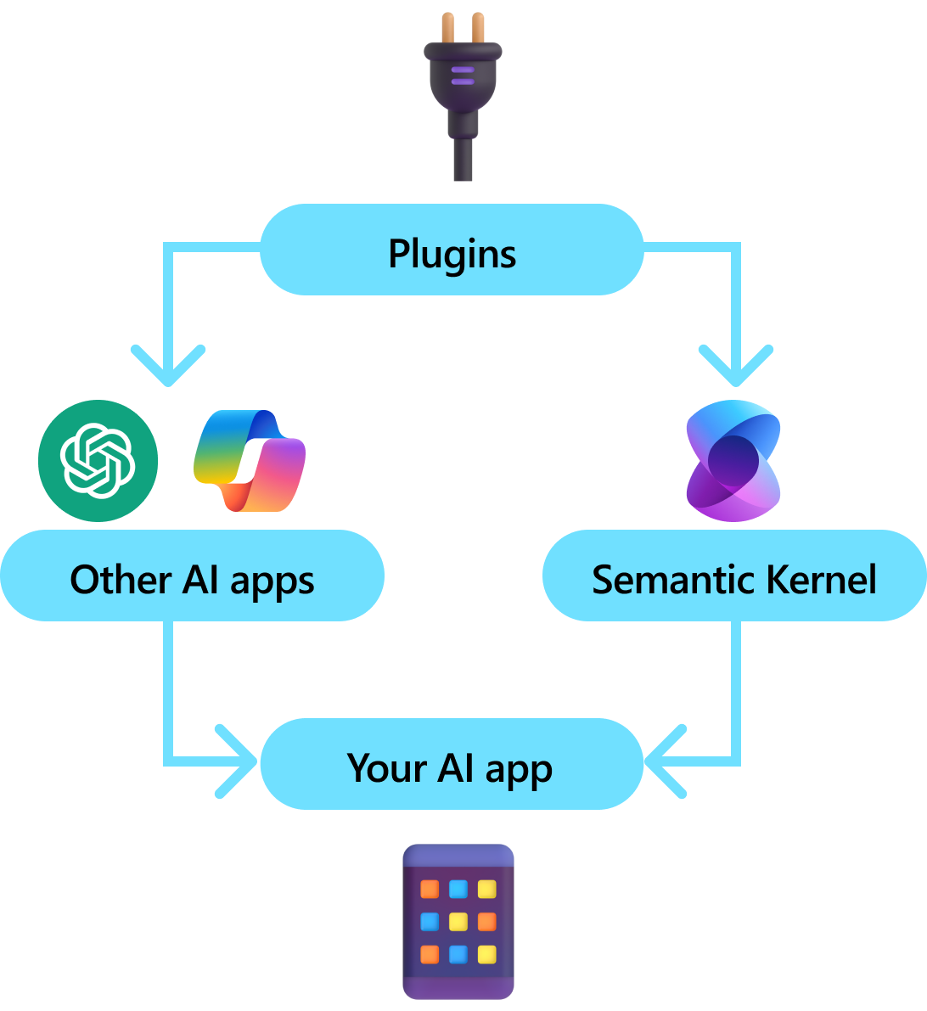



EASY INTEGRATION WITH AI SERVICES

Slide 14
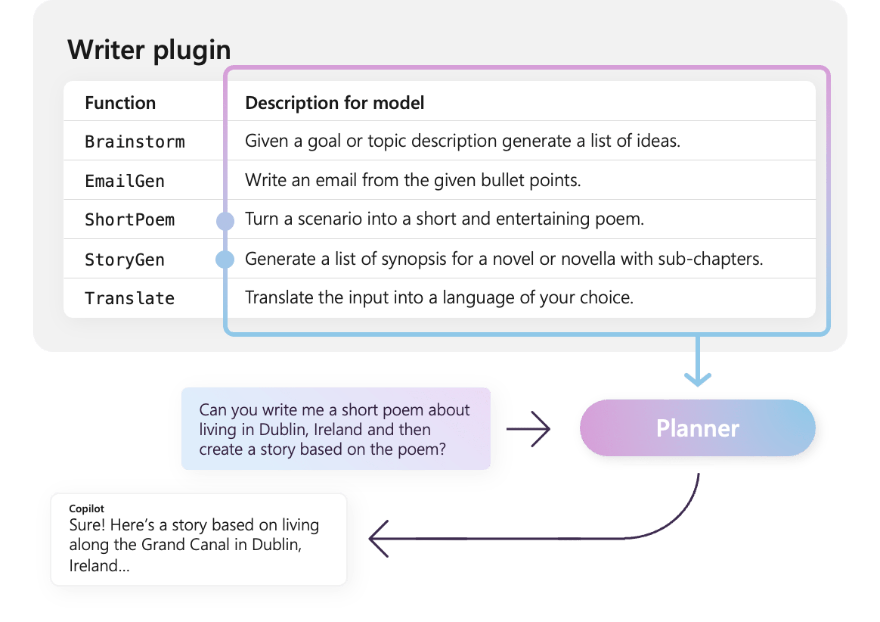

PLUGINS
Model-Context-Protocol
built-in support

Slide 15






MEMORY

Slide 16
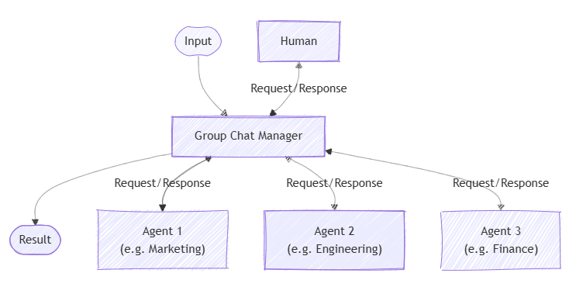
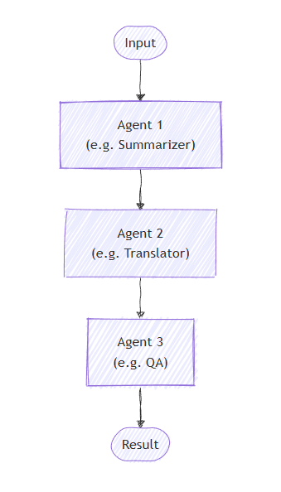
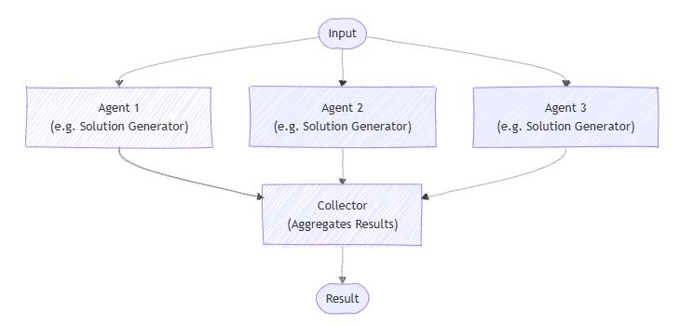
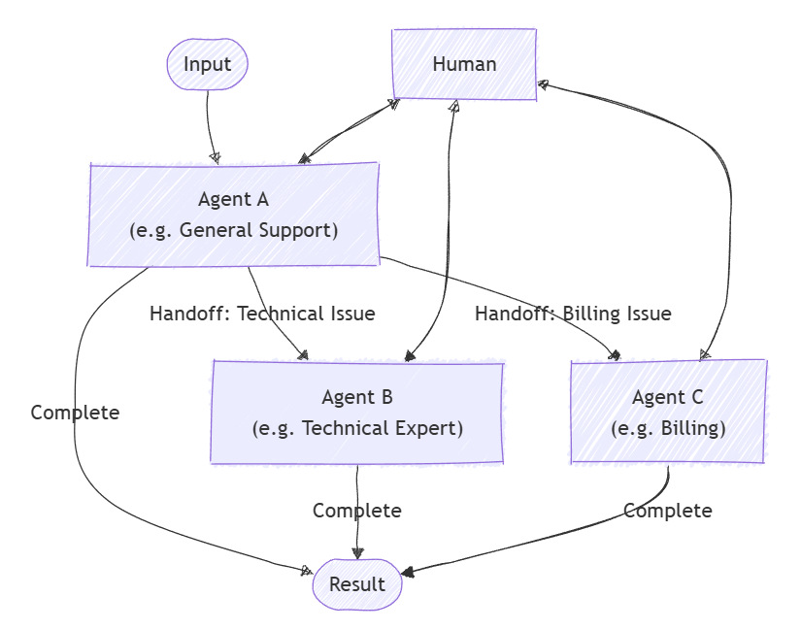
ORCHESTRATION
Group Chat
Concurrent
Sequential
Handoff

